Slide 1
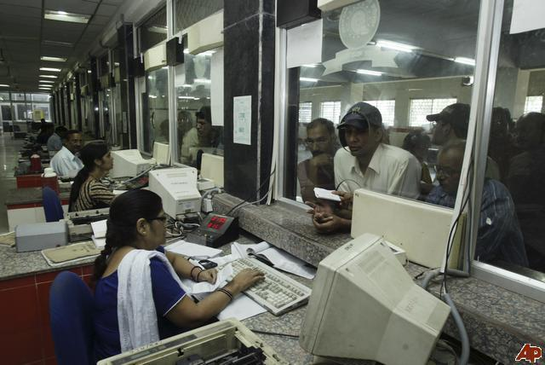
RAILWAY RESERVATION SYSTEM

Slide 2







PROJECT INSIGHT
INTRODUCTION
DISADVANTAGE OF EXISTING SYSTEM
ADVANTAGE OF PROPOSED SYSTEM
ARCHITECTURAL DESIGN
HARDWARE AND SOFTWARE REQUIREMENTS
CONCLUSION

Slide 3

RAILWAY RESERVATION (AN INTRODUCTION)
The railway reservation system facilitates the passengers to enquiry about the trains available on the basis of source and destination, booking and cancellation of tickets, enquiry about the status of the booked ticket, etc. The aim of case study is to design and develop a data base maintaining records of different trains, train status and passengers.This project contains introduction to the railways reservation system. It is the computerized system of reserving the seats of train seats in advance. It is mainly used for a long route. Online reservation has made the process for the reservation of seats very much easier than ever before
In our country India, there are number of counters for the reservation of the seats and one can easily make reservations and get tickets. Railway reservation system, has described above, can lead to error free, secure, reliable and fast management system. It can assist the user to concentrate on their other activities rather to concentrate on the record keeping. Thus it will help organization it better utilization of resources.Administrator of the project, with the help of a password, can enter new train record, display all train records, modify train records and delete train records. The record of train includes its number, name, source, destination, and days on which it is available, whereas record of train status includes dates for which tickets can be booked, total number of seats available, and number of seats already booked

Slide 4
RAILWAY RESERVATION (CONT…..)
In this project we are going to include all the entities related to reservation.
Admin
Customers
Employee

Slide 5

disadvantage of existing system
Data Redundancy
Difficult in accessing data
Limited Data
Not user friendly

Slide 6

advantage of proposed system
All the manual work should be converted into computerized so that the load of employees should decrease.
The database should be stored in computer rather than in register/manually.
Easy to store information and fast accessing of information
Centralized management reporting & decision support
Accurate and timely control program

Slide 7
advantage of proposed system(cont…)
To make it easy for fast processing and modification.
List of accounts of all customers is available.
Easy retrieval of accounts
To make the Railway system is interactive
Quick feed back

Slide 8


Architectural design
STATION DETAIL
CUSTOMER LIST
CANCELLATION RECORDS
TRANSACTION DETAILS
EMPLOYEE
RESERVATION ENQUIRY
CUSTOMER DETAILS
FARE RECORS
RAILWAY
TICKET RESERVATION
ADMIN
CUSTOMER
TRAIN ENGUIRY
TICKET CANCELLATION
TRAIN AVAILABILITY
EMPLOYEE DETAIL
SEAT DETAILS

Slide 9

HARDWARE AND SOFTWARE REQUIREMENTS
1) Hardware Requirements:
Processor : Pentium IV 2GHz and Above
RAM : 1GB
Monitor : VGA Color Monitor
2) Software Requirements:
Operating System : Windows XP onwards
Developing Tool : VB (front end)
Database : My SQL (back end)

Slide 10

conclusion
The aim of the project was to make a complete, fully working online Railway Reservation System.
The architecture describes the user interface, system database, enrollment and authentication modules.
​Our team’s top priority is the reliability and security of the service. Our core innovation principles remain the same:
Build a simple, integrated, and
complete identity solution

